Slide 1


Shiny exploration of high resolution spatial transcriptomics data
RaukR project
2024
Mengxiao He
Tianyu Zheng

Slide 2
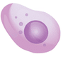




Brief background
Cell types
Epithelial cell
Lymphocyte
Dendritic cell
Myeloid cell
Fibroblast
Notes:
Epithelial cells line body cavities
Lymphocyte, dendritic cells are immune
Myeloid cells blood cells -> mature into adult blood cell
Fibroblasts connective tissue

Slide 3
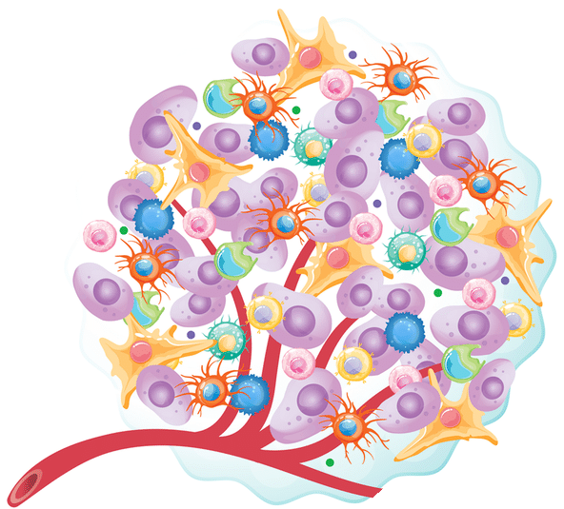




Tissue

Slide 4




Transcriptomics – analysis of the RNA
Bulk RNA sequencing
Single-Cell RNA sequencing

Slide 5
Transcriptomics – analysis of the RNA
Bulk RNA sequencing
Single-Cell RNA sequencing
Spatial information is lost

Slide 6
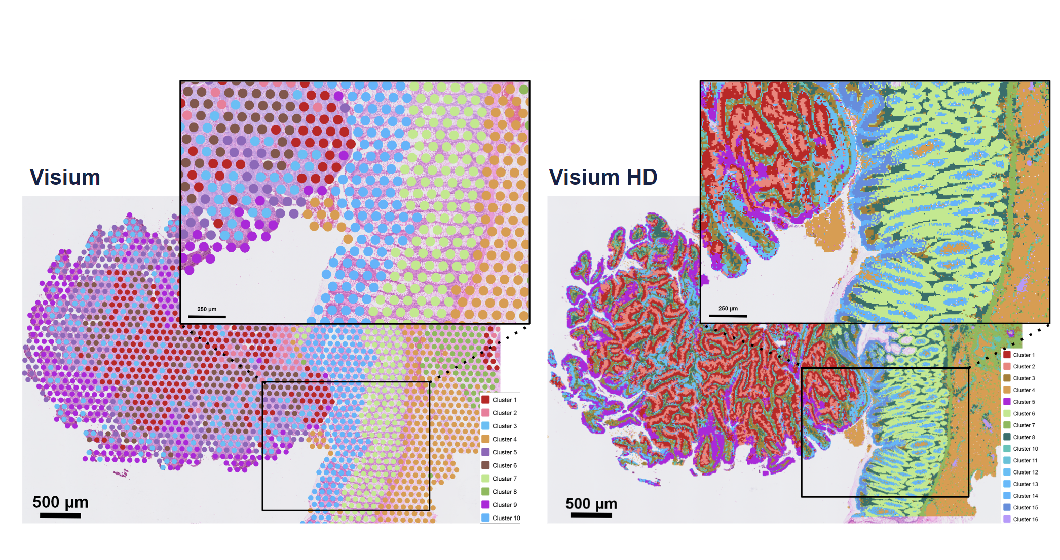
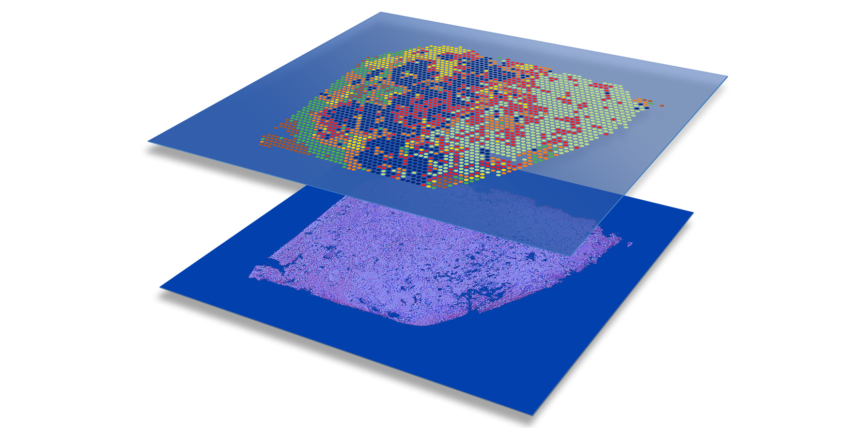
Spatial transcriptomics

Slide 7
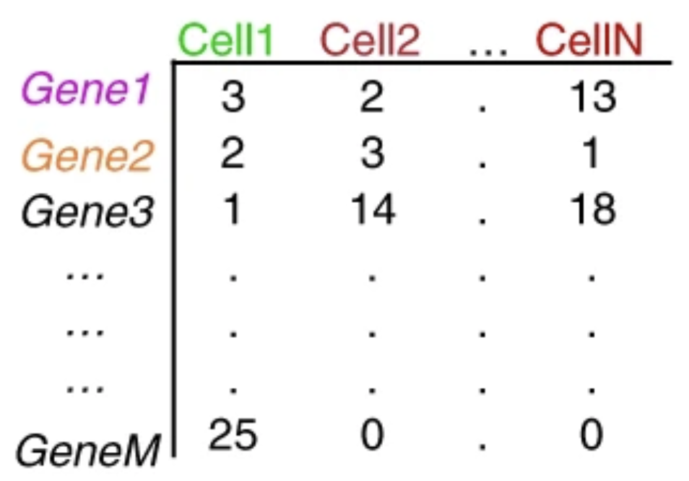
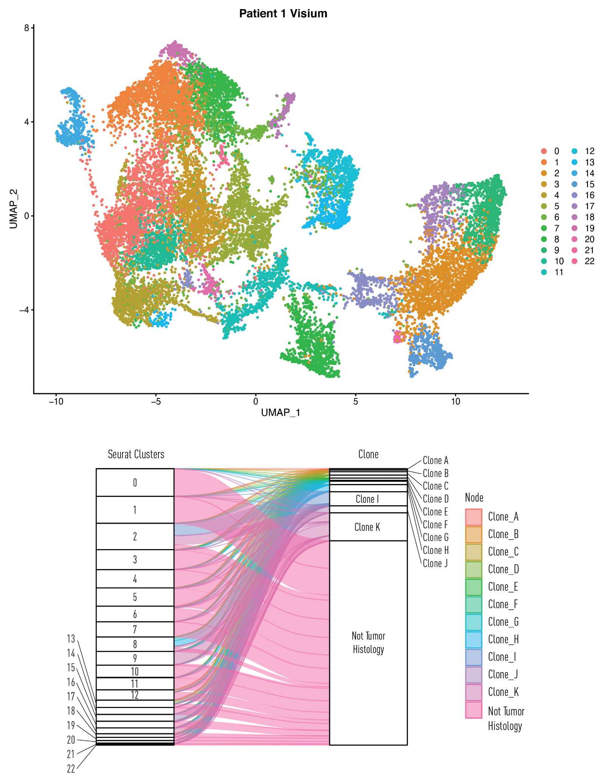
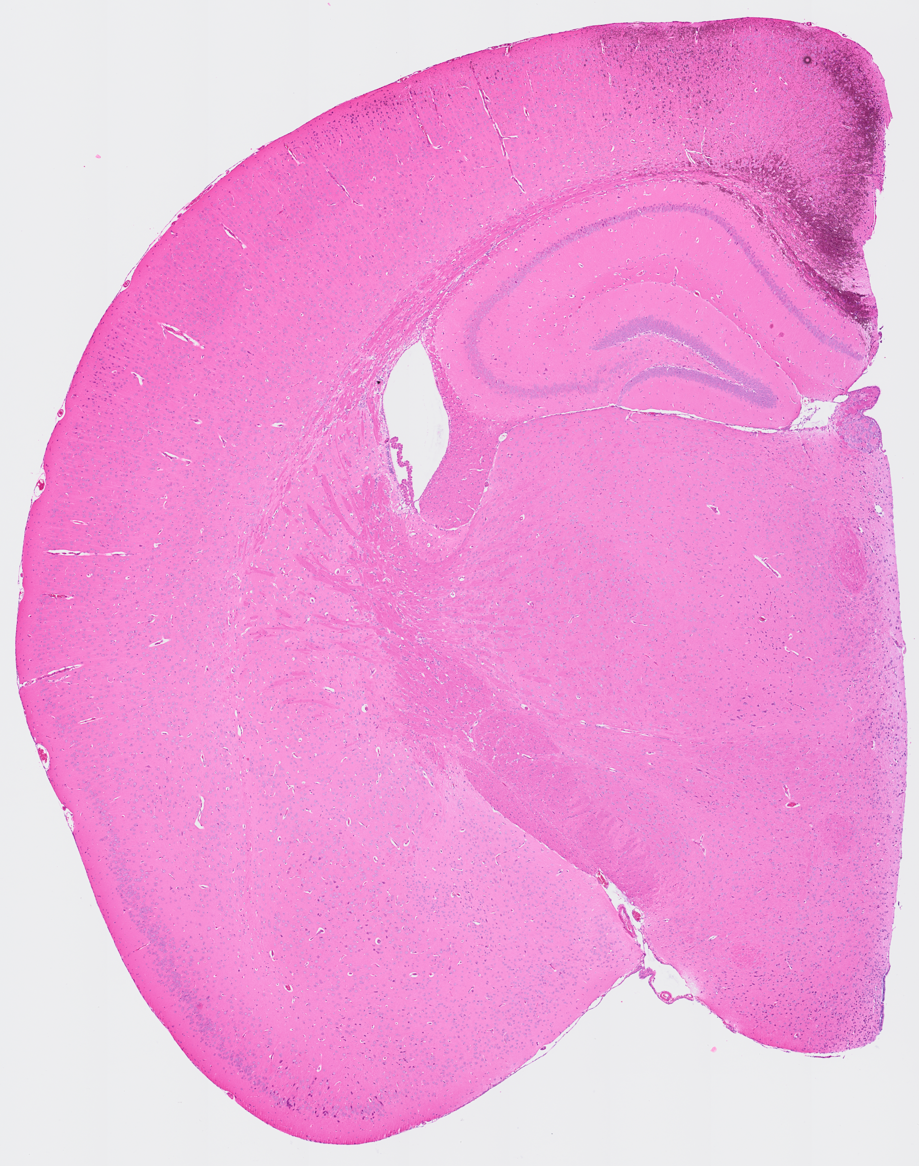
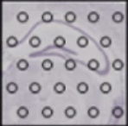
Analysis of spatial experiment data
Also have spatial information

Slide 8
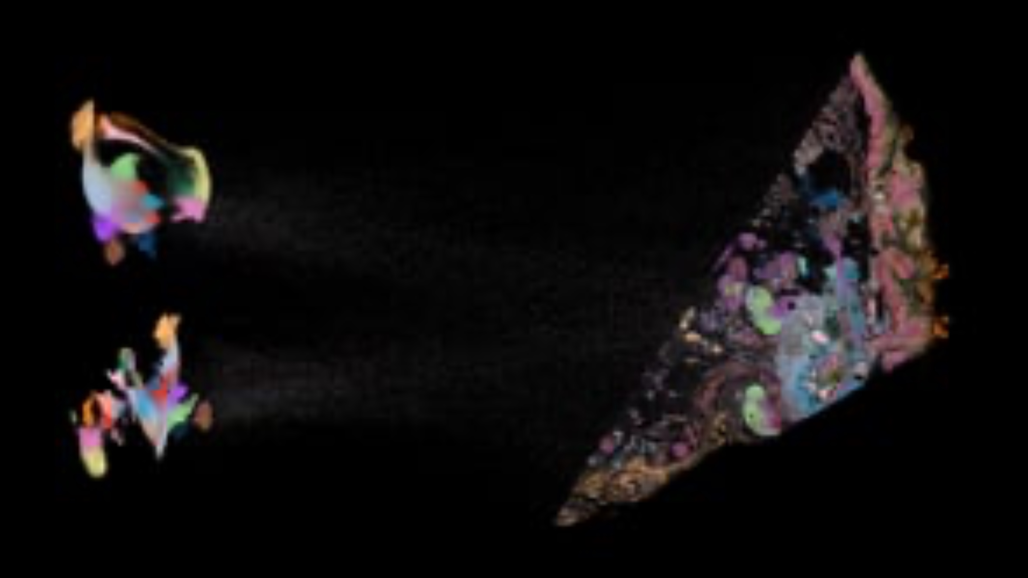
Analysis of spatial experiment data

Slide 9
Shiny exploration of spatial data
Exploration of 10x Visium HD data of Mouse Brain (393 543 spots)
Script for preprocessing Visium HD data (pipeline)
Some parts requires to be run on a HPC
ShinyApp
Explore where genes and biomarkers are expressed
In UMAP space as well as in tissue
Explore where clusters map spatially
Standard clustering
Spatially aware clustering
Facilitates cell type annotation
Validate cell-type deconvolution results
Using histology as reference

